Slide 1
TRANSPARENCY
REPORT 2021
Financial year ending on August, 31st 2021
Pursuant to article R 823-21 of the Commercial Code

Slide 2
Summary
Transparency report 2021
Our firm 3
  Aca Nexia 4
  The group 4
  Activities 4
  2020-2021 fees per activities 5
  Organization 5
  Governance 6
  ATH 7
  Nexia International 7
  Governance 7
  Members independence 8
  Resources 8
  Brand 9
  Quality control 9
  Nexia France 9
2. Risk management 10
  Independence 11
  Internal procedures 11
  Management declaration 11
  Quality control 12
  Quality system 12
  ATH verifications 13
  Management declaration 13
  External inspections 13
3. Clients 14
  Turnover 15
  Nexia International 15
  Nexia France 15
  Aca Nexia 15
  PIE clients 15
4. Human resources 16
  Employees 17
  Partners 17
  Continuing training 18
Pursuant art R823-21 of the French commercial Code, Statutory auditors of Public Interest Entities publish a transparency report on their website within the 4 months of the closing of the fiscal year.

Slide 3
Our firm

Slide 4
Our firm
Aca Nexia
Aca Nexia is an audit, public accounting and consulting firm that, to 31 August 2021, generated a turnover of €30.5M with a total staff of 233 full-time equivalent (FTE) people, including 22 partners. Staff as at August 31st 2021 amounts to 220 people.
The group
Aca Nexia SAS exclusively controls several entities with which it forms an operational group with shared management and organisation. These companies are: Pimpaneau & Associés, IDF Expertise & Conseil, CERA, Thémis, Fleury, SFPB A&C and Aca Ile de France. These entities counts 3 desks in Paris and Ile de France.
Activities
The group offers its expertise in audit services, public accounting and consulting, with 5 main offers:
  Legal audit, consisting primarily of statutory auditors assignments and consular missions consisting of contribution and/or merger audit engagements.
  Public accounting expertise that covers a range of services including the review and preparation of annual financial statements, the Foreign desk, that offers public accounting services for foreign investor establishments and structures in France, consolidation and consulting.
  The Social Management for payroll outsourcing services, declarations for social charges and social management consulting.
  Transaction Services (TS) and Financial consulting, that include due diligence and VDD missions for financial and industrial investors, as well as consulting and support missions in the financial domain.
  Outsourcing of accounting and cash management and related services (BPO).
Entities | Office | Main activities
Aca Nexia SAS, Pimpaneau & Associés SAS, IDF Expertise et Conseil SAS, CERA SAS, SFPB A&C SAS | Paris (75) | Auditing Accounting and tax Outsourcing Transactions Services
Themis SAS Fleury SAS | Argenteuil (95) | Accounting and tax Auditing
Aca Ile de France SARL | Montesson (78) | Accounting and tax Outsourcing Social management

Slide 5
Our firm
Fees 2020-2021 per business lines
The business departments follow the business line at group level, steering technical deployments and providing support to those involved in the business. The business lines are under the responsibility of a partner.
Business lines | Partner in charge
Audit | Olivier Juramie
Accounting | Olivier Lelong
Social | Géraldine Claux
TS et Advisory | Fabrice Huglin
BPO (Outsourcing) | Nady Bendaoud
Organisation
  The firm is organized with offices, each office forming a profit center with its clients, its teams, its own management. The office is the HR management entity. The office is organized in business lines which constitute areas of competence.
  The support functions are under the responsibility of a partner whose mission is to manage a support area at group level.
Business lines | Offices
 | Paris | Montesson | Argenteuil
Auditing | x |  | x
Accounting and tax | x | x | x
Social | x | x | x
TS et Advisory | x
BPO (Outsourcing) | x | x
Functions | Partner in charge
Finance | Géraldine Claux
HR | Olivier Juramie
IT | Philippe Mendes
Marketing | Olivier Lelong
Quality | Laurent Cazebonne
Nexia | Olivier Lelong

Slide 6
Our firm
    Operationally the partners are attached to an office. In Paris, even if they intervene in several fields of competence, they are attached to a business line.
  At present date, François Mahé and Philippe Sallé has retired. Three new partners have been nominated on September 1st 2021 : Mikaël Jacques (Audit), Haiat Zidany (Accounting) et Nicolas Garcia (Social).
  Governance
    Aca Nexia group governance is organized at the level of Aca Developpement, parent company of Aca Nexia. Main company rules of Aca Developpement are as followed:
    Corporate officers includes the President and two managing directors.
    The general management of the group is ensured by a management committee of 3 partners corporate officers of Aca Developpement SAS boards, appointed by the Board of Directors.
    The Board of Directors is composed of 7 members and including 4 members appointed by the General Assembly and 3 members elected by the Committee of Partners. The Board of Directors sets the orientations of the Company's business and monitors their implementation. It is empowered in three additional areas: the appointment of new partners, amendments to the shareholders' pact and decisions on external growth. For these 3 matters, it examines the files on presentation of the management committee and presents them to the committee of partners for decision.
    The Partners' Committee brings together all the partners of the firm. The committee has a right of decision in 7 areas: appointment of partners, modification of the partners' pact, external growth, significant financial commitments, annual consolidated budget, approbation of new Bord of Directors member and share valuation. On these 7 competences, decisions are taken on the principle of a partner a vote, by a majority of ¾.
Partners | Auditing | Accounting | Social | TS et Advisory | BPO
Paris
Nadi Bendaoud |  |  |  |  | x
Daniel Buchoux | x
Laurent Cazebonne | x
Eric Chapus | x
Géraldine Claux |  |  | x
Pascal Cosse | x
Stéphane Dankowsky | x
Sandrine Gimat | x
Fabrice Huglin |  |  |  | x
Olivier Juramie | x
Gwénolé Le Berre |  | x
Olivier Lelong |  | x
François Mahé | x
Philippe Mendes |  | x
Philippe Sallé |  | x
Hervé Téran |  |  |  | x
Argenteuil
Jérôme Debroise |  | x
Bernard Hommel | x
Sylvain Sznek | x
Montesson
Jean-Pierre Jung |  | x
Frédéric Papillon |  |  | x
Stéphane Tuvi |  | x

Slide 7


Our firm
  Aca Nexia is a member of the Association Technique d’harmonisation, ATH, the leading French technical association with membership of 36 independent firms representing over 7,300 people.
  ATH provides pooled technical management and supplies its members with the following services:
  A documentary database with oversight and consulting services, and information dissemination by email.
  Permanent access to information and tools for all of the firm’s members, by means of an intranet system.
  A second-level annual quality control.
  Developments included in our audit Software.
  A training catalogue to help employees to progress in their technical, behavioral and managerial skill.
  Olivier Lelong represents Aca Nexia on the ATH board of directors. The other partners take part in the technical committees on the basis of their areas of responsibility.
  Nexia International is ranked 8th amongst the networks of independent audit and consulting firms. The Nexia International network is present 265 firms over 128 countries. It represents a volume of fees of US $4.5 billion, with 36,076 people including 3 449 partners and directors (source www.nexia.com).
  The network’s activity is shared between audit & accountancy, tax services, corporate finance and management consulting.
  The strength of Nexia International lies in the willingness of its members to share their expertise. The network has defined a strategy and created a true organization operated and maintained by the members themselves.
  Gouvernance
  Governance is defined by the statutes. Nexia is governed by a Council in which all members are represented. The Council shall elect the members of the Board and shall have sole power to amend the Statutes.
  The Board is composed of 7 to 14 members chosen among the partners of the firms member of Nexia, elected by the Council for a renewable 3-year term, including the President elected in his capacity. The Board defines the network strategy and policy.
  The Chairman and his team implement the policy defined at Board level and ensure the operational management of the network.
  The International Audit Committee is composed of 4 to 11 members appointed by the Board and chosen from among the partners of the firms member of Nexia. It carries out the quality control of the members at their admission and then periodically.

Slide 8
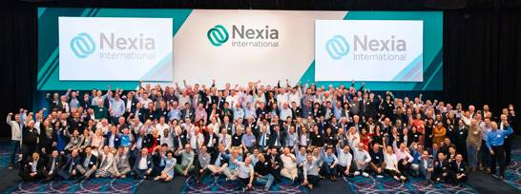
Our firm
  Gouvernance (Nexia International)
  The Audit Committee ensures the promotion of best practices, the organization of conferences, and publications available to members on the website www.nexia.com
  The International Tax Committee is composed of 4 to 11 members appointed by the Board and chosen from among the partners of the firms member of Nexia. It carries out studies on transnational subjects, organizes an annual conference and prepares periodical publications of its work.
  The animation of the life of the network is also ensured by a Regional Director, for each of the 4 regions: Europe - Middle East - Africa, Asia-Pacific, North America, and South America.
  In addition to the meetings of these instances, the network management is punctuated by different meetings to which members are invited to participate: an annual conference of all the members in autumn, an annual Tax Conference in Spring, an "audit Forum" organized concurrently with the annual conference, meetings by region.
  Independance of members
  Members are fully independent from each other in legal terms, in their strategy and in their management.
  Each member is responsible for managing the quality of the services it offers. This is verified within the framework of the quality control program organized by the Audit Committee.
  Resources
  Members pay a contribution according to their annual income, there is no contribution based on the work referred between the members.
  Members pay their travel and living expenses to attend conferences. Partners who takes part to the instances of the network are not remunerated.

Slide 9

Our firm
  Brand
    The members use the Nexia logo in order to assert their membership in the network.
  Quality control
  The articles of association indicate that members who provide services in the audit field must take part in a permanent quality control program that takes into account the audits performed on the members by the national organizations.
  Monitored by the Audit Committee, this program applies the principles and standards of the IFAC. The reviews result in written reports include recommendations and a follow-up.
  The processes maintain the confidentiality of the conclusions towards the other members.
  Each year, a quality questionnaire is filled electronically.
  Nexia France is a non-regulated company, a member of Nexia International, which allows its 6 firms to access the network and use the brand in France: Aca Nexia, ECA, Groupe Y Nexia, Novances, Odycé Nexia and Sefico Nexia. The objective of the company is to coordinate the representation of the network in France. It is led by a steering committee composed of a representative of the six firms. 5 firms are member of ATH, Odycé Nexia has recently join Nexia France, and its subscription to ATH is in progress.
  Nexia has also 3 representative members in France : MSB Avocats, DPZ Avocats et Sevestre & Associés. They do not use the brand Nexia.
  In total, Nexia realizes € 127 millions fees in France and comprises 1 101 people, including 108 partners.

Slide 10
Risk management

Slide 11
Risk management
Independence
The firm has set up a quality management system that integrates a quality manager function and procedures that combine a set of quality-controlled tools.
The quality system covers auditing, accounting and general areas, quality management, human resources and technical documentation.
It is within the framework of this system that the monitoring of respect for the principle of independence and quality control were integrated.
Internal procedures
The principle of independence is taken into account by several procedures of the quality management system for statutory auditors:
  Acceptance and renewal of a mandate
Before accepting a new mandate or renewing an existing mandate, the partner shall, in particular, verify that the principle of independence is respected on the basis of a questionnaire co-signed by a member of the management committee.
  Continuation of an audit engagement
  Whenever necessary, and at least once a year, the partners verify that the conditions for continuing the statutory auditing mandates are still being respected, which they justify with the help of a questionnaire.
  Declaration of independence
  Each year, the firm’s members, partners, and employees, involved or not in statutory auditing missions, are required to sign a certificate that confirms that they have familiarized themselves with the rules contained in the statutory auditing code of ethics and that they comply with the rules set down by the code in terms of independence and incompatibility.
  Training
  The training program for the partners and employees includes presentations of the professional rules regarding the independence of statutory auditors.
  Management declaration
    Aca Nexia management declares that the compliance with the independence principle is periodically verified within the firm.
  Rotation
    Aca Nexia has implemented a rotation of the audit partners for the mandates of public interest entities and public entities with generosity as well as their significant French subsidiaries, in accordance with the legal requirements that require a rotation after 6 consecutive exercises (within the limit of 7 years) with a period of emptiness of 3 years. The independence policy of Aca Nexia also provides for the rotation of the "independent auditor" on these same bases. To ensure the correct application of the principles of rotation, Aca Nexia gathers the necessary information and has also set up a planning for these rotations.

Slide 12
Risk management
Quality control
  Quality system
The firm's quality system was approved by decision of the Executive Committee on November 15, 2005.
It includes the appointment of a partner responsible for quality and the establishment of procedures.
Procedures define the specified manner of performing an activity:
The succession of activities and their development.
Responsibilities and actors.
Internal standards and tools.
Annually, the quality partner reports on compliance with procedures in an annual report.
This report includes proposals for corrective and preventive actions, which are submitted to the members' committee and approved by the management committee.
Areas | Procedures
General Procedures | Quality Management Recruiting Training Assessment Documentation Combating money laundering Independence Collection of reports
Statutory accounting | Acceptance of new mandates Incompatibilities Engagement letter Supervision and continuation of the mandates Independence review Conduct of an audit mission
Public accounting, annual financial statements | Acceptance of the mission Mission statement Performance of the mission Supervision
CSR | Integrated manual: Acceptance, conduct, supervision and maintenance of CSR missions
Other missions | Acceptance of the mission

Slide 13

Risk management
  ATH verifications
Statutory auditing, annual accounts and social missions are reviewed as part of an annual audit. Controls are carried out jointly by Aca Nexia (first level) and ATH (second level). The results of these checks shall be included in the annual report drawn up by the person responsible for quality.
  Management Representation Statement
The management of Aca Nexia declares that it has taken all necessary steps to implement the processes and means appropriate to quality control in its statutory audit missions in compliance with the code of ethics and standards of professional practice .
  External inspections
The offices of the Aca Nexia Group are supervised by the High Audit Committee (H3C), the Ordre des Experts-Comptables (OEC), Nexia International and COFRAC for CSR.
The latest checks carried out by these instances are as follows:
October 2021: OEC review, recommendations received in December 2021.
July and October 2021: control of the H3C, report to be received.
Janvier 2020 : evaluation of COFRAC, report received on May 20, 2021.
August 2013 : control of Nexia International according to the internal Limited Scope Review (LSR), final report received on October 4, 2013.

Slide 14
Clients

Slide 15
Clients
Turnover
List of APE and AGP clients
    Nexia International
The Nexia International network achieved a turnover of $ 4.5 billion in 2020, making it the world’s 8th place. This include $ 1.6 billion for Audit and assurance services.
    Nexia France
Nexia France brings together the firms Aca Nexia, ECA Nexia, Groupe Y Nexia, Novances, Odycé Nexia and Sefico Nexia and makes a total of € 127 million of turnover including € 32 million for audit.
    Aca Nexia
    As at August 31, 2021, the Aca Nexia group generated revenues of € 29 million, of which fees for statutory audit were 37% or € 11.4 million.
  This table presents the list of Public Interest Entities (PIE) for which the firm performed a legal inspection of their financial statements during the past fiscal year.
  (*) Non PIE since transfer to Euronext Growth on November 18, 2021
  Aca Nexia is also statutory auditors of Believe, coted on Euronext A since June 2021.
APE | Fiscal year | Nature of PIE
Axway Software | 31.12.20 | Quoted on Euronext C
Barbara Bui | 31.12.20 | Quoted on Euronext C
CA Indosuez Wealth (France) | 31.12.20 | Credit institution
Caisse de Refinancement de l’Habitat | 31.12.20 | Credit Instituion / Bonds Issuer
Europacorp (*) | 31.03.21 | Quoted on Euronext C
Mutuelle Bleue | 31.12.20 | Mutual livre II
Micropole | 31.12.20 | Quoted on Euronext C
Groupe Open | 31.12.20 | Quoted on Euronext B
Passat | 31.12.20 | Quoted on Euronext C
RBC Paris Branch | 31.12.20 | Credit Institution
RBC Investor Services Bank France | 31.12.20 | Credit Institution
Sopra Steria Group | 31.12.20 | Quoted on Euronext A
Wavestone | 31.12.20 | Quoted on Euronext B
Audit fee detail | m€
Legal audit of IPE | 1,6
Legal audit of other entities | 9,3
Other services invoiced to entities for which we are the legal auditor | 0,5
Other services invoiced to entities for which we are not the legal auditor | 0,0
Total chiffre d'affaires audit | 11,4

Slide 16
Human resources

Slide 17
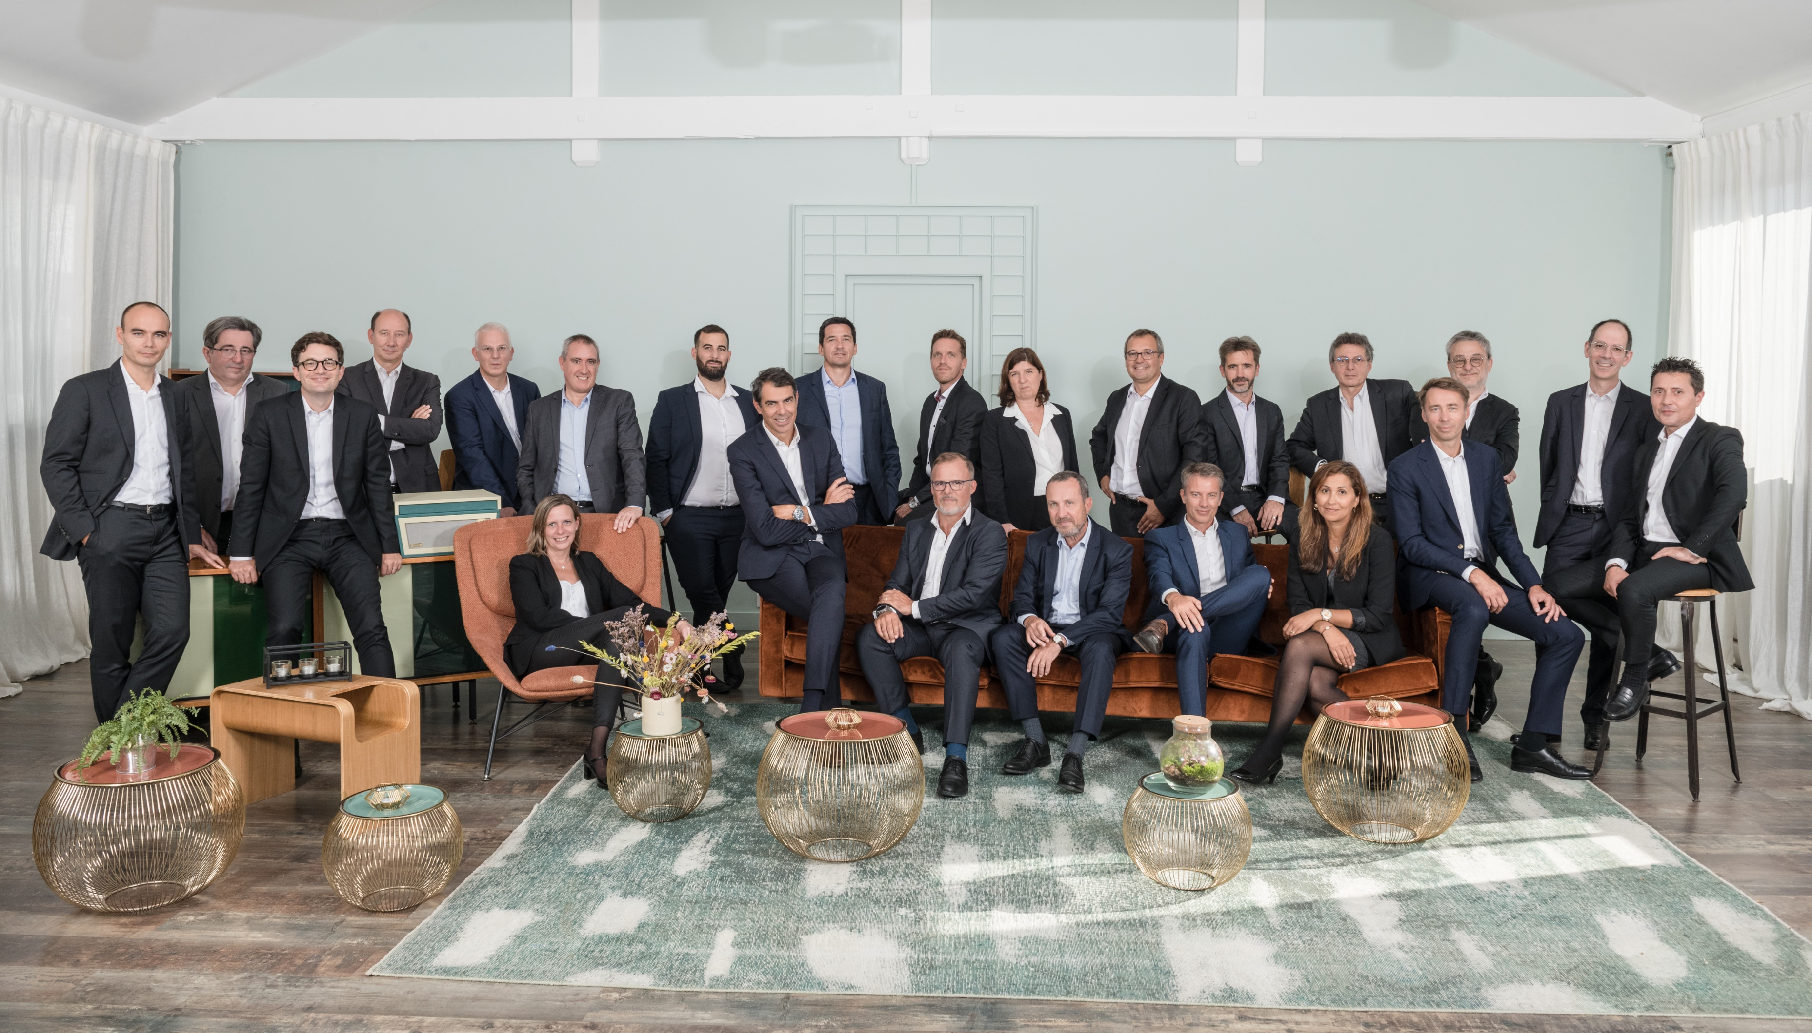
Human resources
Employees
Partners
The Nexia International network has 34,698 employees and partners. The Nexia France members together form a workforce of 1,101 people.
The average workforce of the Aca Nexia group during the fiscal year ended August 31, 2021 expressed in Full Time Equivalent (FTE) was 233 persons, as follows:
Aca Nexia SAS has 22 partners, directly or through participating companies. The shareholders hold at least one share in the capital of the statutory auditor entity to which they are signatories. In accordance with professional rules, when they are not corporate officers, they have an express delegation.
The remuneration of the partners shall be determined by the Management Committee. It include a fixed and a variable part based on one or more performance aggregates of the office to which they are attached. They also receive dividends.
FTE | Total | Audit | Non Audit | Support
 | 233 | 65 | 152 | 16
The partners and employees presented above are allocated according to their main activity. Some of them, at all levels, are required to perform Audit and Non-Audit services.
Functional staff are involved in the following support functions: Human Resources, Marketing & Communication, administrative & Corporate Services, Administration & Finance and IT.

Slide 18
Human resources
Continuing training
Training is the subject of a procedure that is part of the firm’s quality system, and it involves all of the technical personnel, including the persons dedicated to public accounting activities who are not involved in legal certification missions.
The essential elements of this procedure are the following:
Annual orientation meetings from the management committee.
Preparation of an annual training plan on the basis of the individual needs.
The training plan includes a basic course of study, specific general actions, individual actions, the preparation for professional examinations and the completion of the mandatory work placements.
The employees involved in legal certification missions must follow a basic course of study that primarily includes the following
topics : audit techniques, taxation, legal aspects of the statutory auditor mission, consolidation, financial techniques and office automation tools.
Formalization of an annual appraisal.
Aca Nexia management declares that it has set up a training plan for the partners and registered statutory auditors, in response to the training obligations in effect as of January 1st 2009 pursuant to the order of 19 December 2008, which requires a period of 120 hours of training that must be provided over an interval of 3 consecutive years.
Paris, December 14th, 2021
For the management committee
Olivier Lelong
Signature

